Slide 1

Report Project INTERNET CAFE MANAGEMENT SYSTEM
Supervisor:
Mrs. Shreya Banerjee
Students:
Nguyen Minh Man - 1831209008
Nguyen Trung Hieu - 1531219004
Nguyen Tien Dat – 183120004
Nguyen Xuan Doanh - 1831209004

Slide 2
CONTENT
SOFTWARE PRODUCT INTRODUCTION
PROJECT PLAN AND IMPLEMENTATION
DESIGN CUSTOMER-ORIENTED WEB-PAGE
CODING STANDARD AND TEAM WORK
PRESENT PROJECT AND CONCLUSION

Slide 3
Project Introduction
INTRODUCTION
Internet Cafe Management Software is a simple PHP/MySQL project that can help a certain coffee shop to manage invoices or customer orders and receipts.
This system stores a list of menus or products that a cafe or restaurant serves with their prices, and a list of products sorted by category.
This being a Desktop based application is extremely accessible. Information and Records are overseen in incorporated data set. Information is secured and simple to recover, store , and examine

Slide 4

PROJECT PLAN AND IMPLEMENTATION
Function requested by the client(Group 4)
Project implementation

Slide 5

Function requested
Organization of work

Slide 6
REQUIREMENT
PROJECT PLAN
Check and add computer users
Fast service payment
Manage and allocate staff
Reporting and organization
Additional functions are added to the system
Announce on home page, change system name and background interface.

Slide 7

Introduction PHP
PROJECT IMPLEMENTATION
PHP is an acronym for "PHP: Hypertext Preprocessor"
PHP is a widely-used, open source scripting language
PHP scripts are executed on the server
PHP is free to download and use

Slide 8

Application Installer
INSTALL PROGRAM
PHP
MySQL
phpMyAdmin
HTML/CSS
JQUERY,JAVASCRIPTBitamine-Red

Slide 9
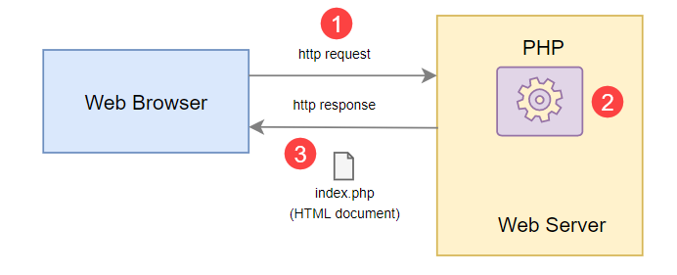
STRUCTURE

Slide 10
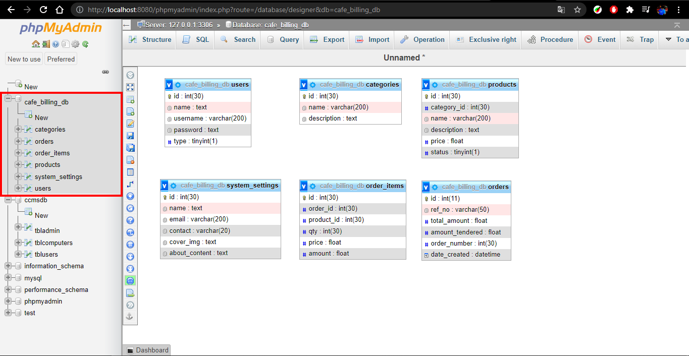
PHPMYADMIN INTERFACE

Slide 11
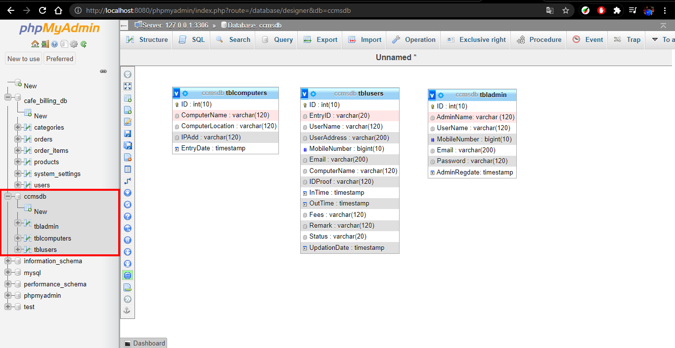
PHPMYADMIN INTERFACE

Slide 12

DESIGN WEB WITH PHP
DESIGN HOME PAGE BILLING COFFEE WEB
DESIGN INTERNET CAFE MANAGEMENT SYSTEM

Slide 13
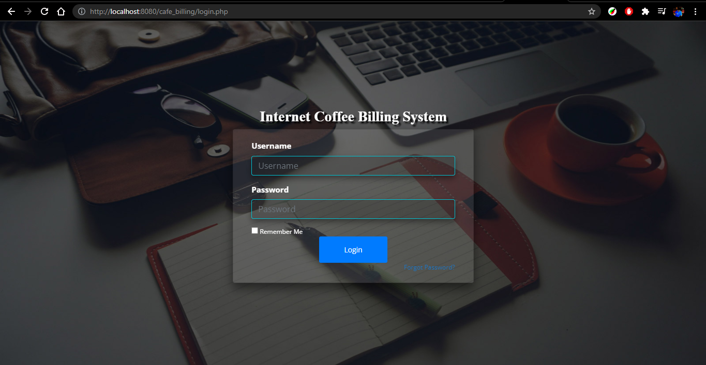
DESIGN HOME PAGE BILLING COFFEE WEB

Slide 14
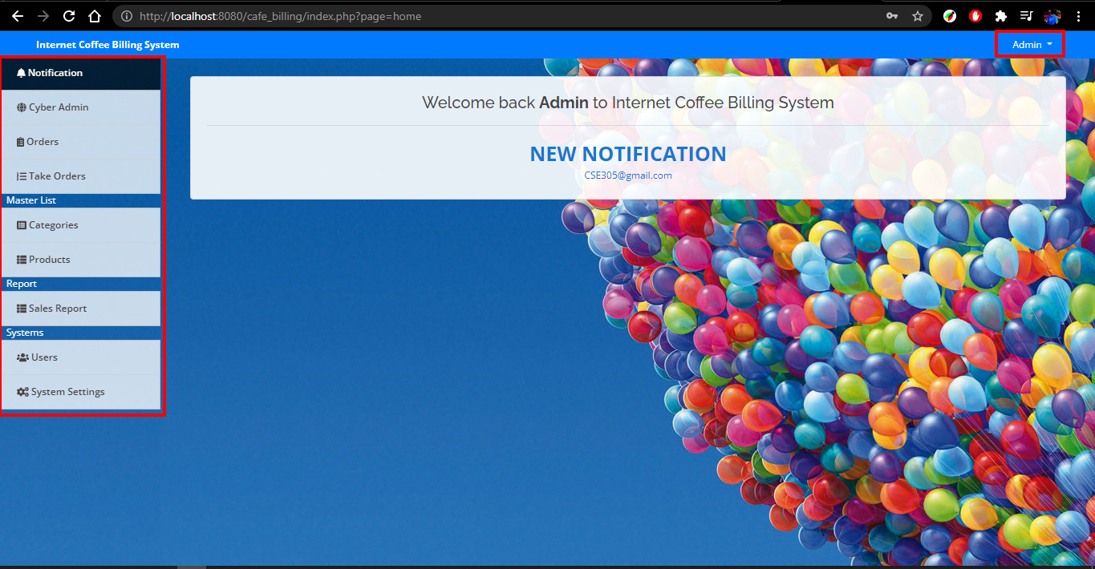
DESIGN HOME PAGE BILLING COFFEE WEB

Slide 15
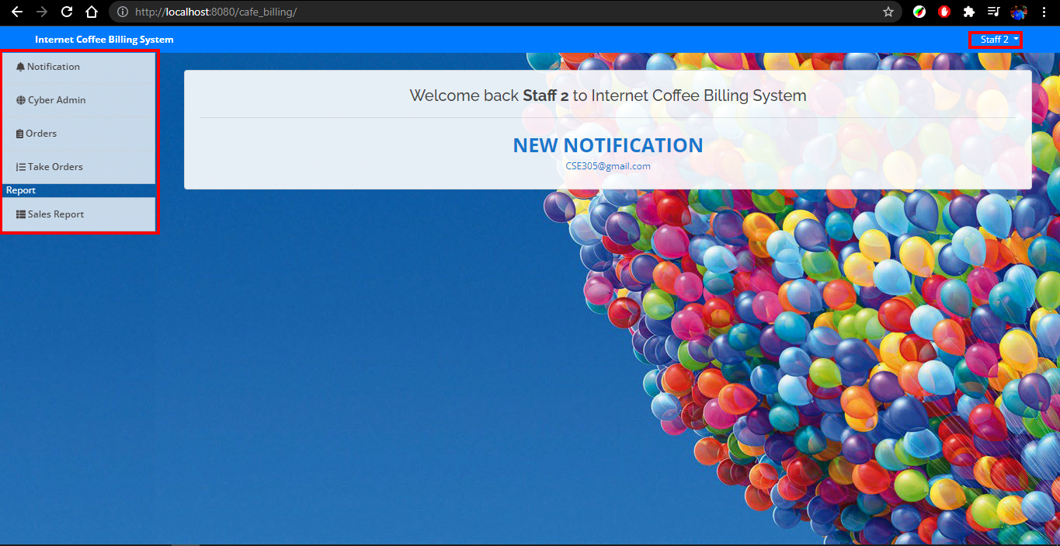
DESIGN HOME PAGE BILLING COFFEE WEB

Slide 16
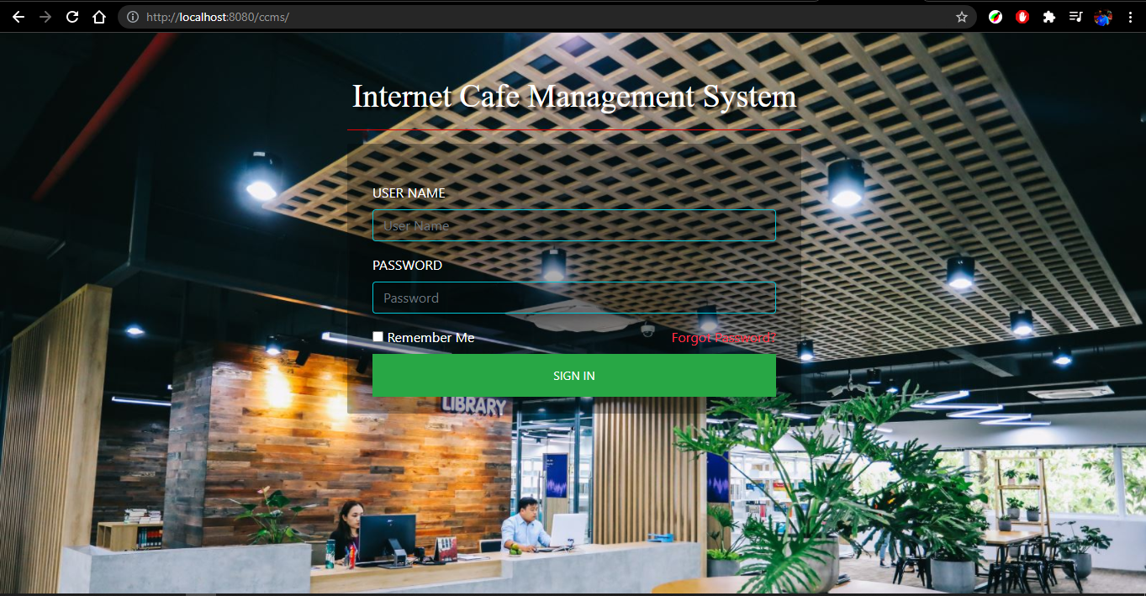
DESIGN LOGIN INTERFACE

Slide 17
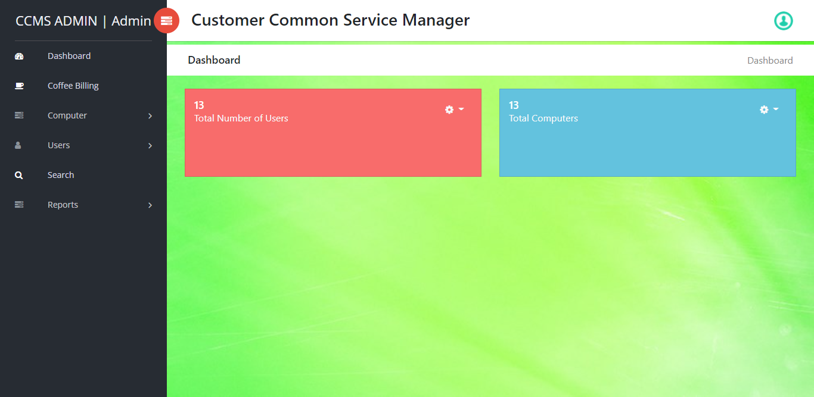
DESIGN INTERNET CAFE MANAGEMENT SYSTEM

Slide 18

ASSIGN TEAM
Organization of work

Slide 19

Assign Team
CODING STANDARD AND ASSIGN TEAM
Design the entire web interface using HTML/CSS:
Nguyen Minh Man
Database design for website using MySQL/phpMyAdmin:
Nguyen Tien Dat
Software design and overall website using PHP/AJAX/JQUERY/JAVASCRIPT:
Nguyen Trung Hieu
Nguyen Xuan Doanh

Slide 20
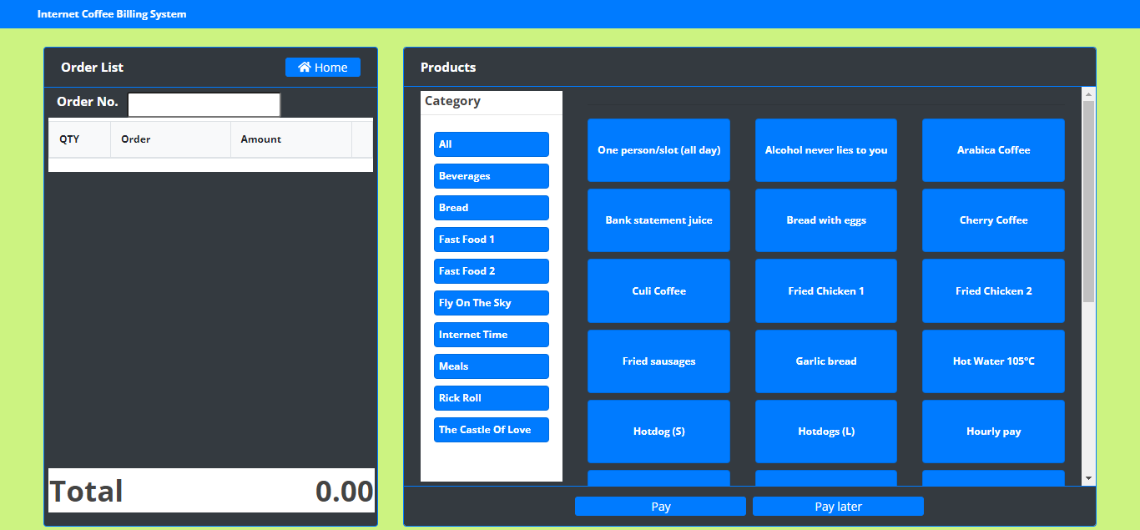
DEMO PROJECT
Show and explain
Design customer-oriented web-page with projects of my team.

Slide 21


Any questions?

